Slide 1
QRIC Stakeholder Reference Group
Monday 30 October 2023

Slide 2
Agenda
Opening &Welcome
Previous Minutes / Actions
Introduction to General Counsel, Cheriden Farthing
Update on Racing Appeals Panel (RAP)
Thoroughbred Racing Penalty Guidelines
Extreme Weather Policy consultation
VIC Racing Integrity Commissioner's Report
Committee Charter - review
Key issues/opportunities
GAP Sub Committee – draft greyhound euthanasia rule

Slide 3
Opening & Welcome
QRIC proudly acknowledges all Aboriginal Peoples and Torres Strait Islanders, the Traditional Owners and Custodians of the country on which we live and work.
We acknowledge their continuing connection to land, waters and culture and commit to ongoing reconciliation.
We pay our respect to their Elders past, present and emerging.

Slide 4
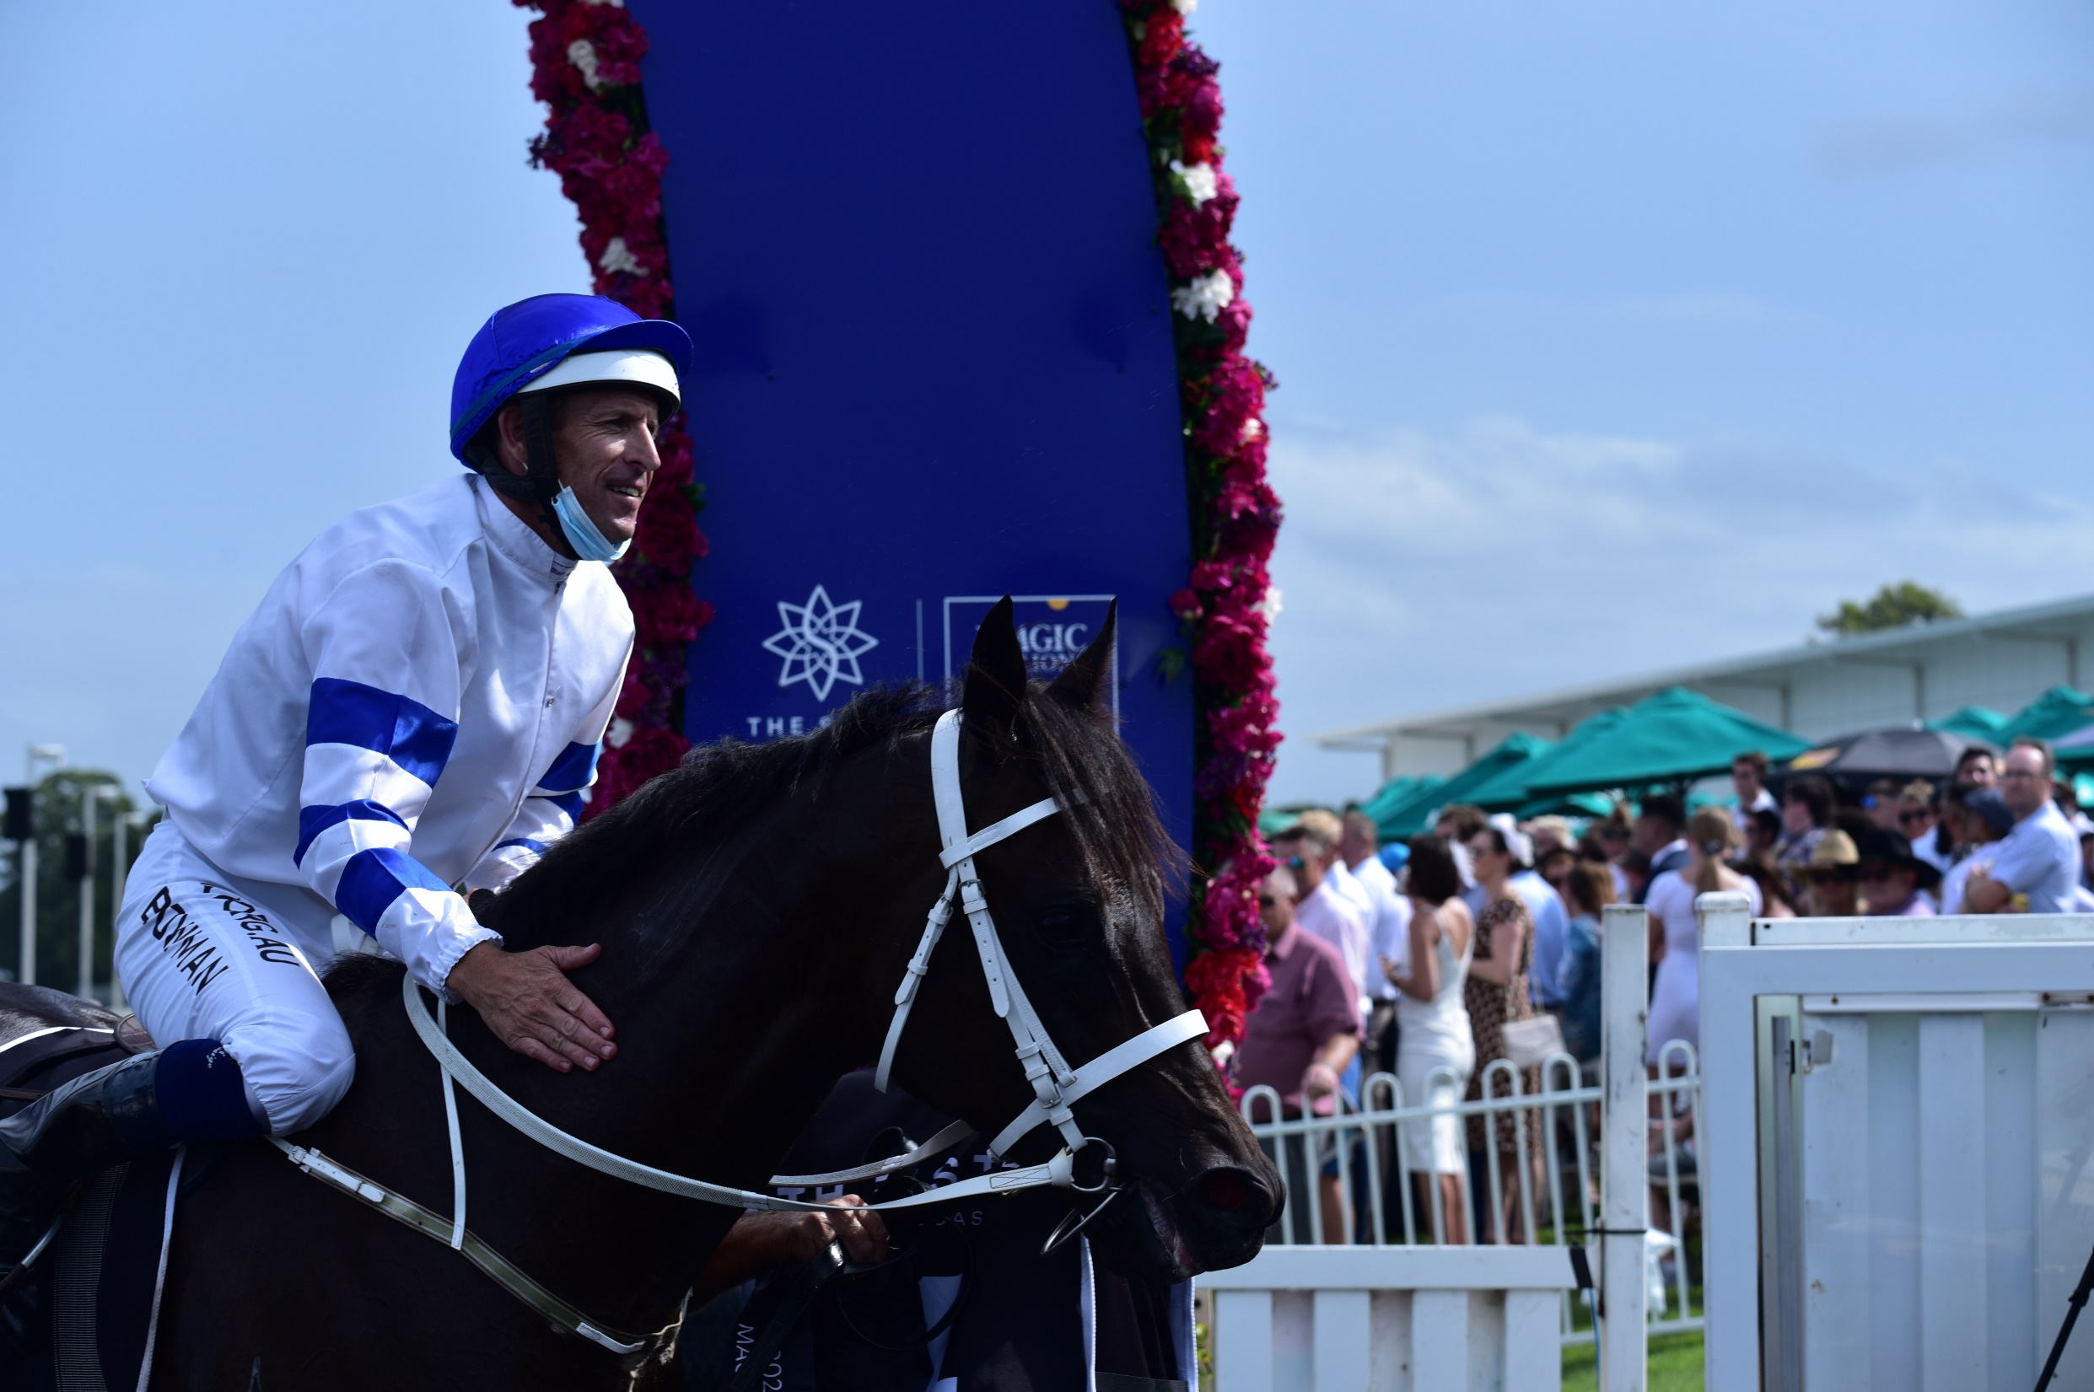
Previous SRG Minutes from 22 June 2023

Slide 5
Introduction to General Counsel
Cheriden Farthing

Slide 6
General Counsel
Division | Scope | Examples
1. Legal Services | Advisory services | Statutory interpretation (e.g. powers) Compliance (e.g. Rules) Corporate/commercial operations (e.g. IR/ER; leasing) Risk (e.g. liability)
 | Advocacy | External reviews - RAP, QCAT, Other (Appeals), Magistrates Court
 | Administrative | Internal review decisions
2. Compliance | Stewards | Compliance investigations Race day stewarding
3. Intelligence | Regulatory | Data driven insights Targeted operations

Slide 7
Racing Appeals Panel – update
General Counsel
Cheriden Farthing

Slide 8
Reform of review processes
Pre-31 March 2023
Internal review by QRIC
External review to Queensland Civil and Administrative Tribunal
Post-31 March 2023
Review processes retained for decisions
Expanded to introduce Racing Appeals Panel for racing decisions
41 applications to RAP - approx. 4% of racing decisions appealed

Slide 9
Applications
Outcomes

Slide 10
Appeal of external review decisions
RAP appeal - limited in nature:
question of law only
‘disqualification action’ that prevents a person from betting, bookmaking, racing an animal, or attending a race meeting for a period of 3 months or more
This approach is justified because
an objective of establishing an independent review panel is
to finalise review applications in a shorter timeframe

Slide 11
External review comparatives
Significantly reduced timeframes to finalise matters
Riding offence example - date of incident to date of hearing:
QCAT - 19 months
RAP - 13 days
Access – filing fees
Representation – lawyers
Expertise – Panel constitution
* All timeframes are approximate
Steps in process | QCAT Example | RAP Example
Date of Incident | 05.02.2021 | 06.10.2023
Date of Stewards Report/decision | 05.02.2021 | 10.10.23
Application for internal review | 05.02.2021 | N/A
Internal review decision made | 05.03.2021 | N/A
Appeal filed | 10.03.2021 | 12.10.2023
Compulsory Conference (CC) held | 06.09.2021 (6 mths from filing) | N/A
Hearing date | 06.09.2022 (1 year after CC) | 19.10.2023
Decision date | 21.03.2023 (6 mths after hearing) | 19.10.2023 (Same day)
Total time taken from incident to hearing | 578 days (19 months) | 13 days (Less than 2 weeks)
Total time taken from incident to decision | 774 days (26 months) | 13 days (Less than 2 weeks)
Total time from appeal filed to external review decision | 741 days (25 months) | 7 days

Slide 12
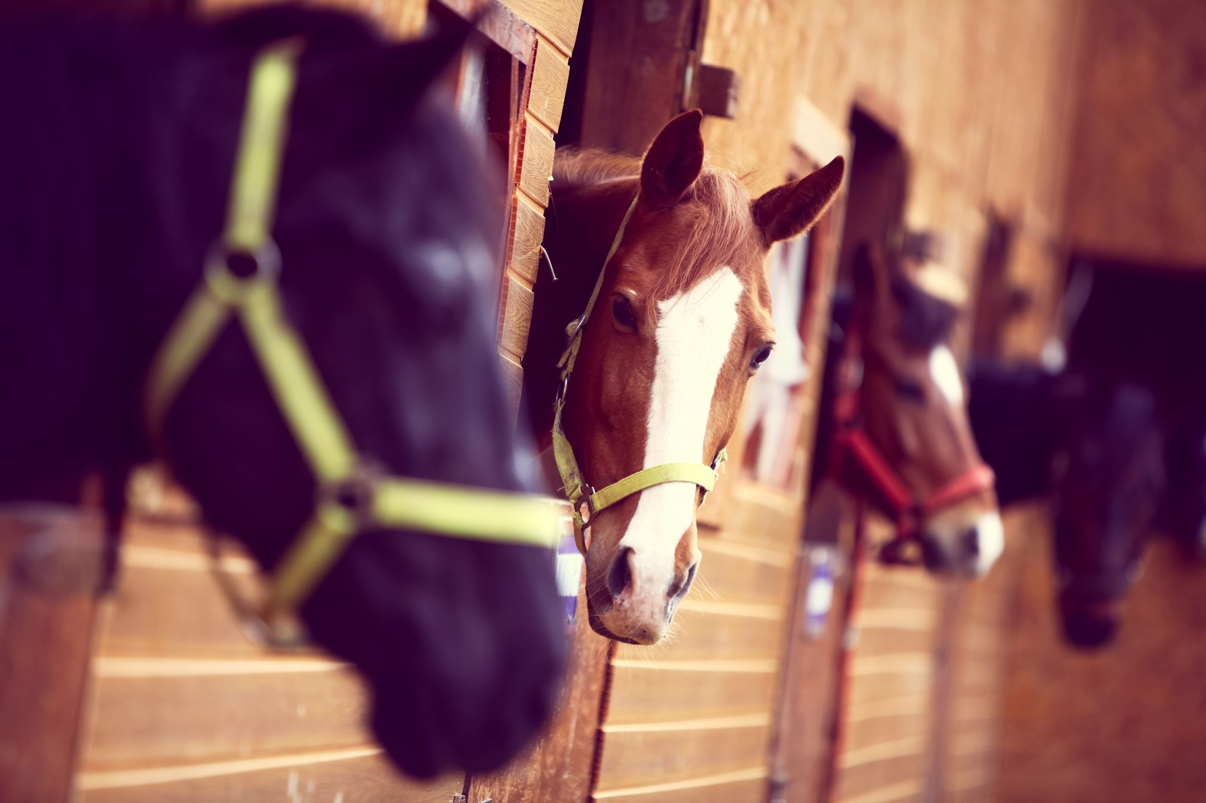
Thoroughbred Racing Penalty Guidelines
Chief Steward
Josh Adams

Slide 13
Thoroughbred Racing Penalty Guidelines
The Thoroughbred Racing Penalty Guidelines underwent a review and were updated.
The new Guidelines were approved on 29 September 2023 with an effective date of 1 October 2023.
Amendments included:
the update of riding offences under AR131 with the table of penalties updated.
the addition of the Careless Riding Template (the Template)
The new Guidelines and Careless Riding Template (the Template) are available at https://qric.qld.gov.au/licensing-and-ownership/thoroughbred/standards-and-rules/

Slide 14
Thoroughbred Racing Penalty Guidelines
The Template formalises the process of how stewards
come to a final penalty to allocate.
It ensures that there is:
consistency
transparency
professional processes.

Slide 15
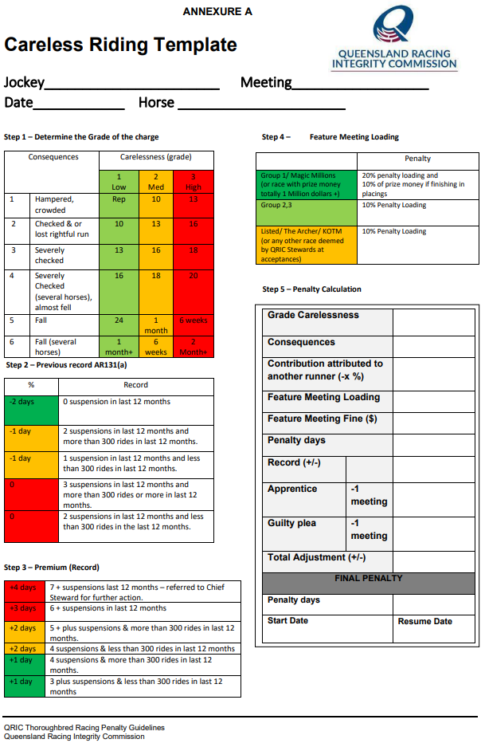

Slide 16
The Guidelines Template
Provides four steps Stewards must consider when assigning a penalty:
Step 1 – Determine the Grade of the charge
Step 2 – Previous record AR131(a)
Step 3 – Premium (Record)
Step 4 – Feature Meeting Loading

Slide 17
Draft Extreme Weather Policy
GM, Animal Care and Advocacy Andrew Langford

Slide 18
Extreme Weather Policy
No consolidated Policy covers decision making for all weather events, only high temperature
Temperatures used previously was air temp which didn’t factor in relative humidity, so was not universal for the state (i.e., 38 degrees in Mt Isa is not the same as 38 degrees in Brisbane/Cairns).
Prior policies did not have a mandated cut off temperature, leaving abandonment at the discretion of stewards. This policy has a nationally recognised (in racing and human athletes) cut-off WBGT with air temp backup for redundancy.
The policy, up until the mandated cut-off temp allows for stewards to still use discretion, but specifically states decisions are to be made in consultation with Racing Qld, Sky (where applicable), club staff, racing participants, and importantly, on-track veterinarians (OTVs).
This Policy factors in the health of jockeys, staff and racing participants as well as the animal athletes.
Aim to implement for 2023/24 Summer

Slide 19
VIC Racing Integrity Commissioner's Report
Commissioner
Shane Gillard

Slide 20
Independent review into VRI Victim Support and Complaint Processes
Outline of the report recommendations
Wide and varied consultation was undertaken
Next Steps:
Form local working group

Slide 21
SRG Committee Charter - review
Secretariat
Sandra Gordon

Slide 22
Committee Charter
The first annual review of the Committee Charter
Good practice to regularly review
Proposal of new inclusions/exclusions for example:
- Recording of meetings via MS Teams
Out of session responses by 30 November

Slide 23
Jurisdictional Comparison
QRIC recently engaged KPMG to undertake a short state by state comparison of integrity operations

Slide 24
State by State Comparison of functions
The summary below shows the functions performed by each states racing bodies. QRIC is unique as no other all codes integrity body exists in Australia.
The closest to QRIC is GWIC in NSW who provide integrity services to greyhound racing (but do not provide GAP or analytical laboratory services to all three codes.
Key factors driving resources are the number and type of meetings managed, the number of staff needed at a meeting and the location of the meeting.
The above data shows that in 2022, QRIC and RQ services more meetings with fewer employees across a larger geographical spread compared to other states' control bodies.

Slide 25
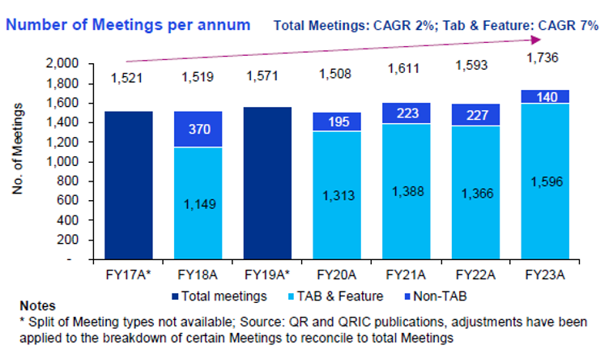
Significant growth in TAB meetings
The number of meetings serviced by QRIC has increased from 1521 in 2016 when the organisation was first formed, to 1736 in 2023
Over the period of 7 years, the number of TAB meetings has grown significantly, making up 88% of races compared to 75% in 2016/17.
TAB meetings require more resources to run than non-TAB, and so they cost more to run as almost twice the number of integrity roles are required including more stewards, judges, vets, and sample collection officers, for example.

Slide 26
QRIC Funding over time
The graph below shows that in 2022, QRIC received $18m from racing revenue and $12.9m from the state government.
Funding increases were largely related to state government grants for increases in enterprise bargaining agreements and initiatives related to the Martin Inquiry.
Since 2016, there has been no additional funding for the roles that run races such as stewards, vets, sample collection officers and no additional welfare funding (other than Martin Inquiry), or increases in funding for GAP.

Slide 27
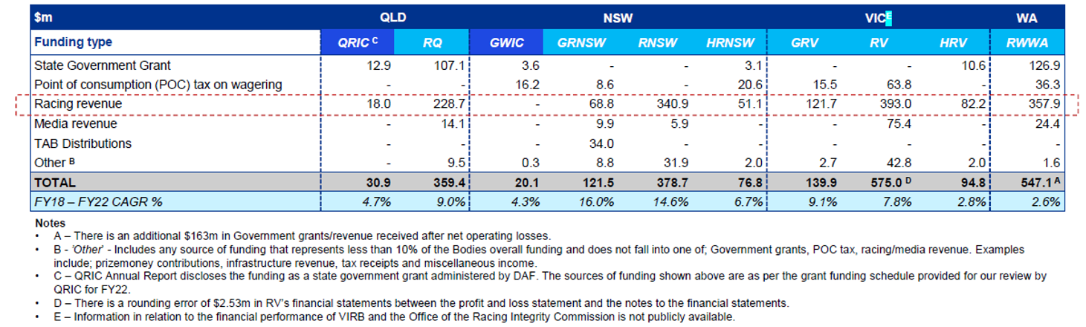
Snapshot of State by State Funding
The table below was extracted from various Annual Reports from 2022 and we have attempted to align figures where possible, for comparison purposes.
Statewide costs for racing for all three codes in FY22 was:
Queensland: $390.3m to run 1593 meetings
NSW: $597.1m to run 2398 meetings
WA: $547.1m to run 880 meetings (plus off-course wagering services)

Slide 28
Shane.Gillard@qric.qld.gov.au Natalie.Conner@qric.qld.gov.au Chris.Reid@qric.qld.gov.au QRIC.SRG@qric.qld.gov.au
Thank you

